Slide 1
Software Engineering
CSE-3203

Slide 2
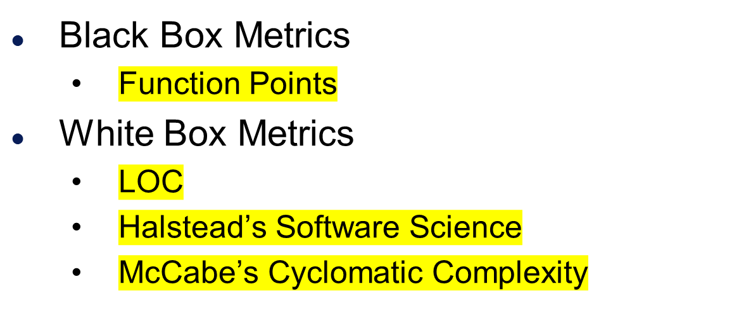
Software Metrics

Slide 3
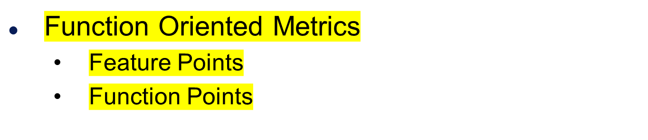
Black Box Metrics

Slide 4
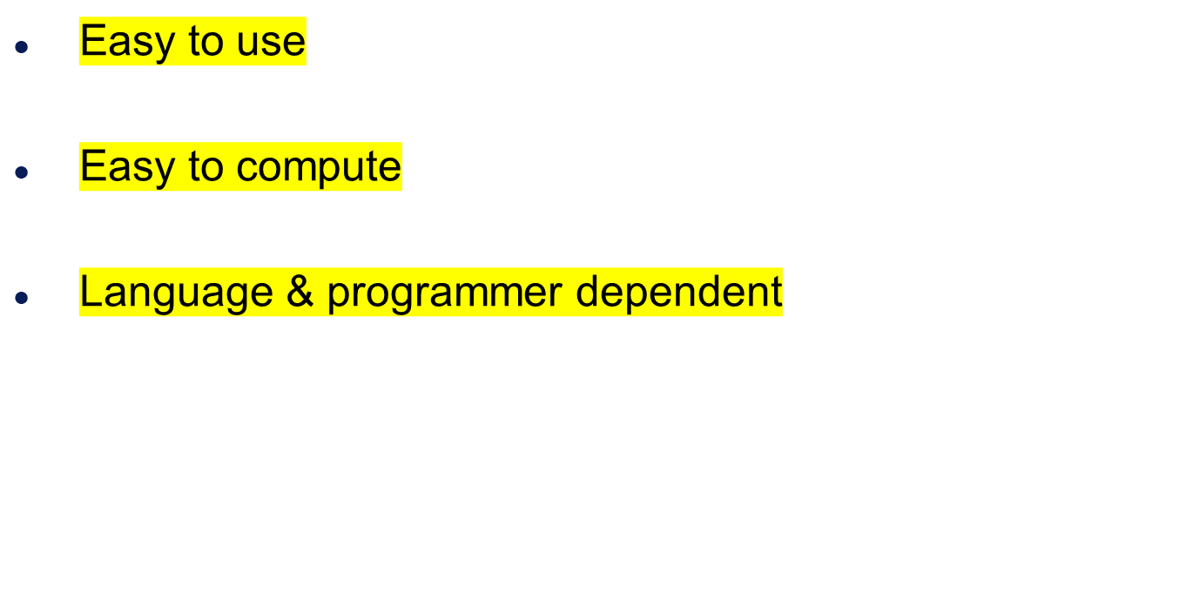
LOC Metrics

Slide 5
Size-oriented metrics
Example of simple size-oriented metrics
  Errors per KLOC (thousand lines of code)
  Defects per KLOC
  $ per KLOC
  Pages of documentation per KLOC

Slide 6
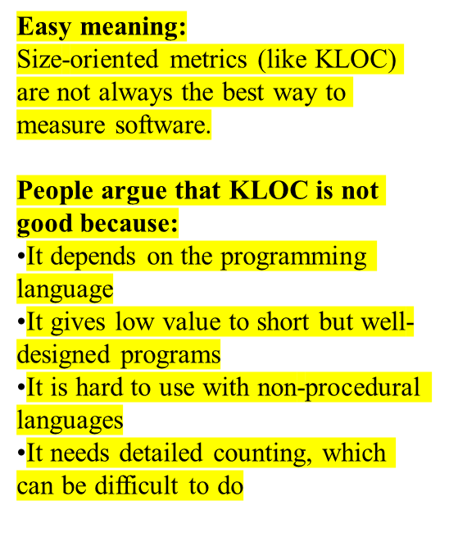
Problems
Size-oriented metrics are not universally accepted as the best way to measure the software process
Opponents argue that KLOC measurements
  Are dependent on the programming language
  Penalize well-designed but short programs
  Cannot easily accommodate nonprocedural languages
  Require a level of detail that may be difficult to achieve

Slide 7

Mainly used in business applications
The focus is on program functionality
Most common are:
  function points, and
  feature points (FP) .

Slide 8
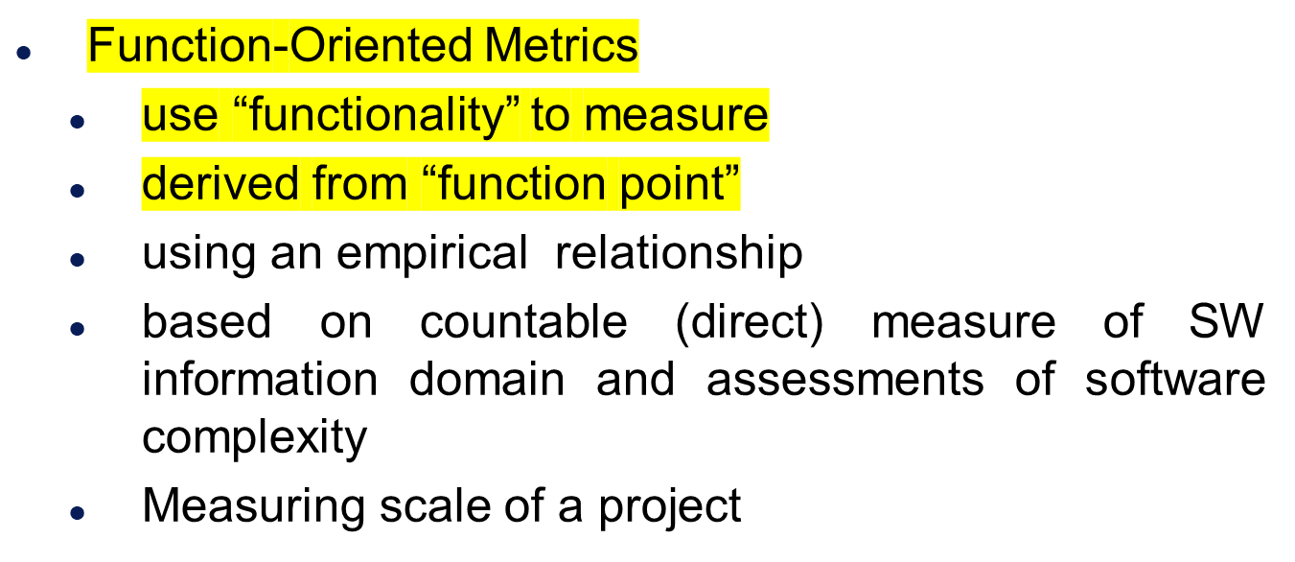
Software Measurement

Slide 9

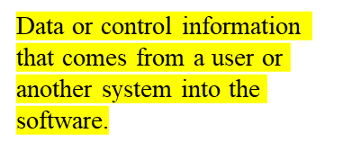


Number of external inputs (EI)
  Originates from a user or is transmitted from another application and provides distinct application-oriented data or control information
Number of external outputs (EO)
  Derived within the application and provides information to the user
Number of external inquiries (EQ)
  Interactive inputs requiring a response

Slide 10
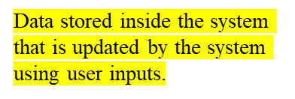
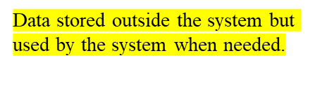
Information domain values
Number of internal logical files (ILF)
  A logical grouping of data that resides within the application’s boundary and is maintained via external inputs
Number of external interface files (EIF)
  A logical grouping of data that resides external to the application but provides data that may be of use to the application

Slide 11
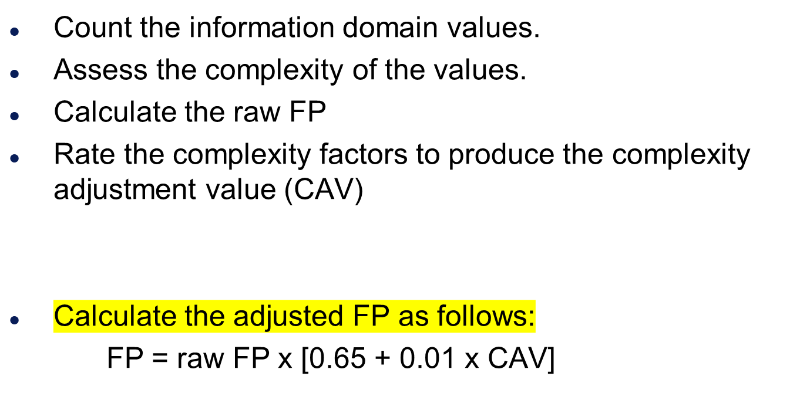

Steps In Calculating FP

Slide 12
Step 1
Count the information domain values Number of external inputs
  Number of user inputs
  Number of external outputs
  Number of external inquiries
  Number of internal logical files
  Number of external interface files

Slide 13
Step 2
Assess the complexity of the values
  Simple, Average, Complex
  Determined based on organisational experience based criteria. Nonetheless, the determination of complexity is somewhat subjective
  Compute count total

Slide 14
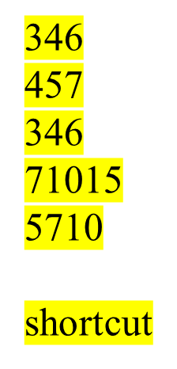
Step 3:
Calculate the raw FP
Weighting Factor
Parameter Count Simple Average Complex
Inputs x 3 4 6 =
Outputs x 4 5 7 =
Inquiries x 3 4 6 =
Files x 7 10 15 =
Interfaces x 5 7 10 =
Count-total (raw FP)

Slide 15
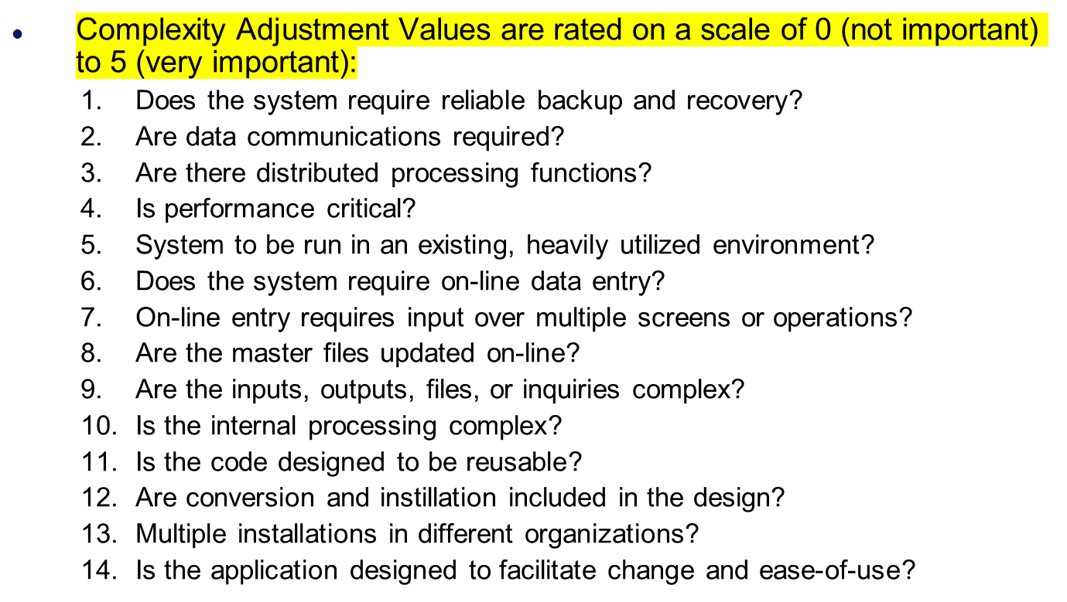
Complexity Adjustment Value

Slide 16
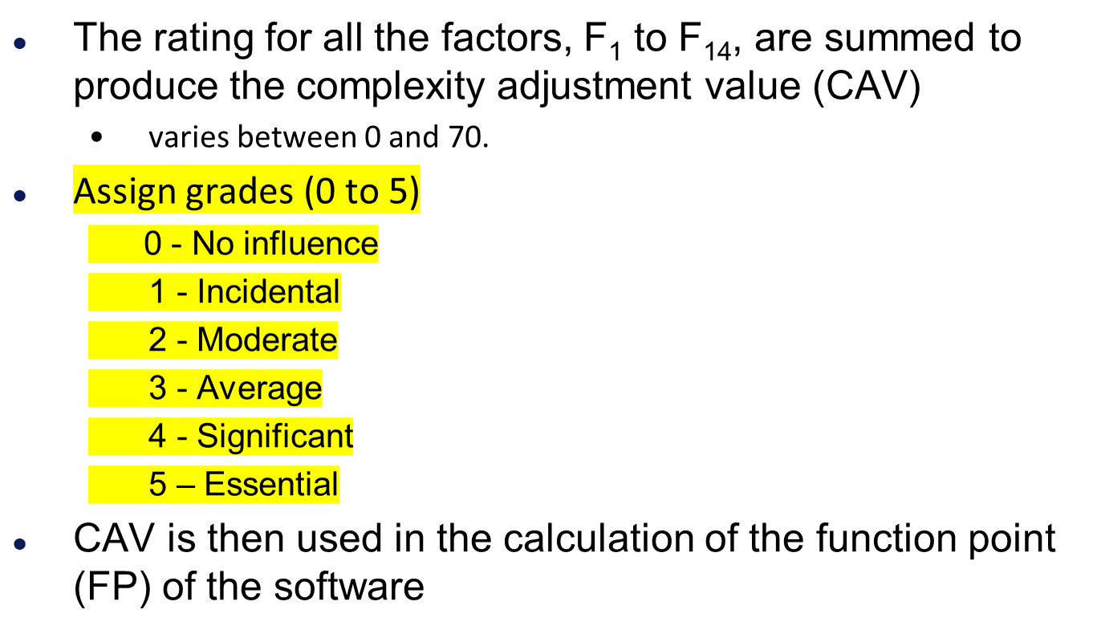
Complexity Adjustment Value

Slide 17
Step 4
Assess the complexity of the values

Slide 18

Step 5
Calculate the adjusted FP as follows:
FP = raw FP x (0.65 + 0.01 x CAV)

Slide 19




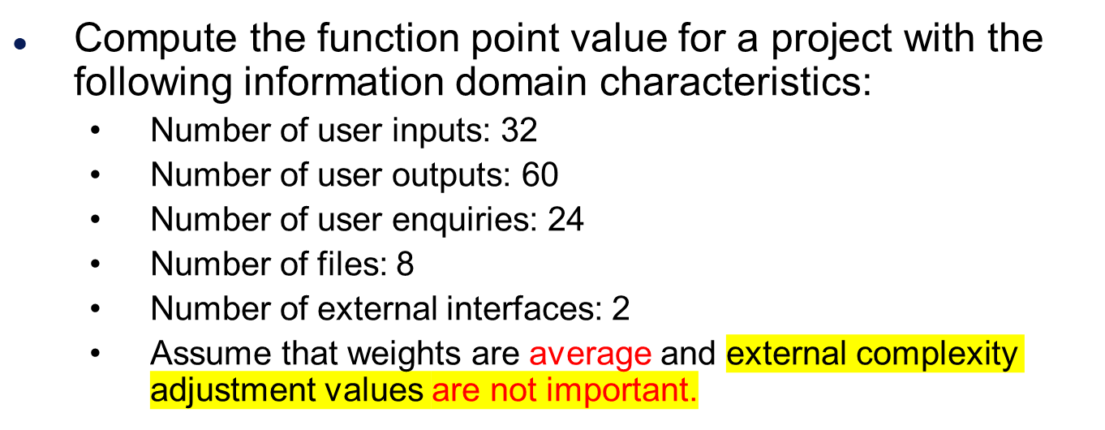
Exercise: Function Points
CAV=0

Slide 20
Solution
Weighting Factor
Parameter Count Simple Average Complex
Inputs x 3 4 6 =
Outputs x 4 5 7 =
Inquiries x 3 4 6 =
Files x 7 10 15 =
Interfaces x 5 7 10 =
Count-total (raw FP)
32
128
60
300
24
96
8
80
2
14
618

Slide 21

Solution
CAV= 0
Raw FP=618
FP = raw FP x (0.65 + 0.01 x CAV)
= 618 x (0.65 + 0.01 x 0)
= 401.7

Slide 22
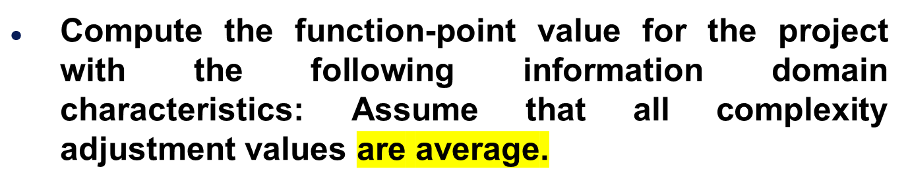
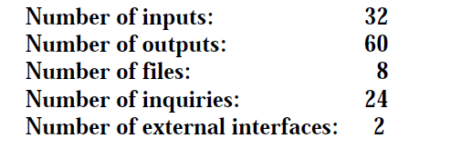
Example

Slide 23
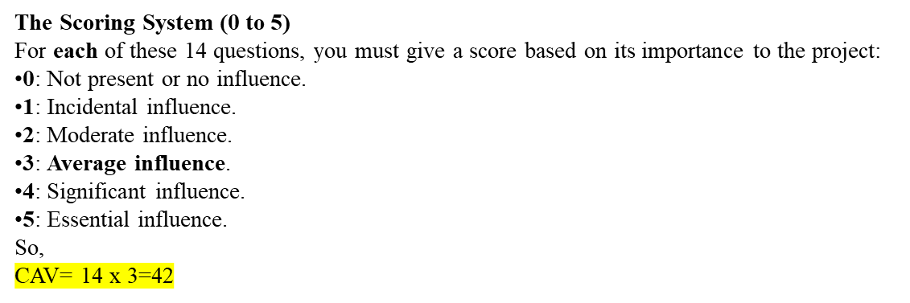
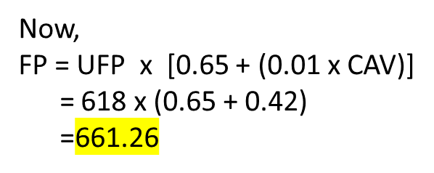
Example
Unadjusted Function Points:
Number of inputs: 32 x 4 = 128
Number of outputs: 60 x 5 = 300
Number of inquiries: 24 x 4 = 96
Number of files: 8 x 10 = 80
Number of external interfaces: 2 x 7 = 14
Total UFP: 128 + 300 + 80 + 96 + 14 = 618

Slide 24
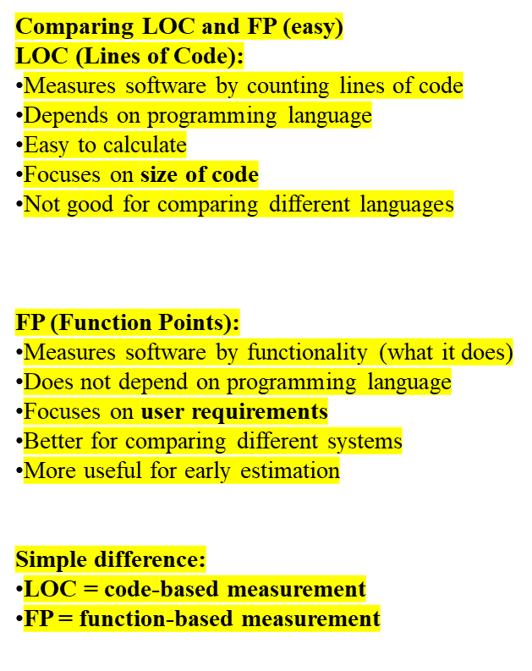
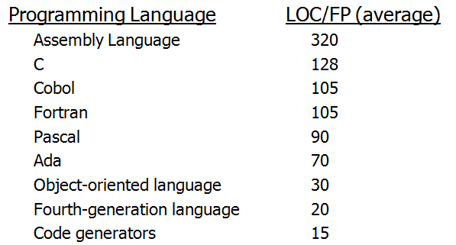
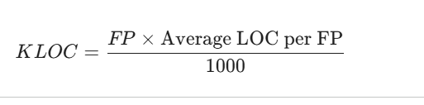
Comparing LOC and FP
LOC Per Function Point
For C++:
KLOC = (401.7 * 64)/1000 = 25.7088 KLOC

Slide 25
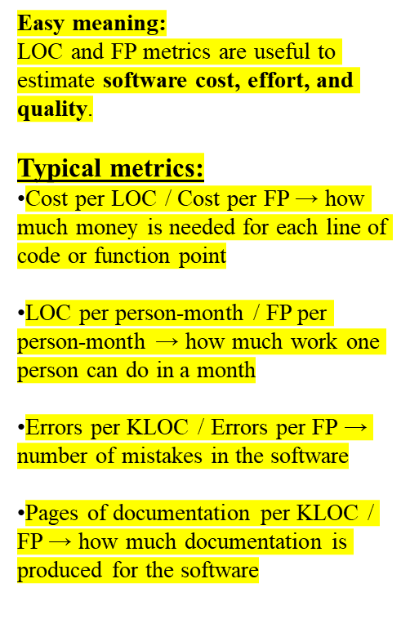
LOC and FP
LOC and FP-based metrics have been found to be relatively accurate predictors of software development effort and cost
Typical metrics
  $ per LOC, $ per FP
  LOC per person-month, FP per person-month
  errors per KLOC, errors per FP
  pages of documentation per KLOC, pages of documentation per FP

Slide 26
END

